Slide 1
ENGR 12
Dr. Mandala
Notes:
Down

Slide 2
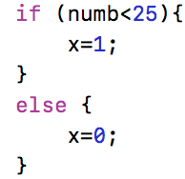

C shortcuts
A common expression in programming is the if-else statement.
C provides a shortcut using ternary operator ?
if (relational condition)
x = expression-a;
else
x = expression-b;
x = relational condition ? expression-a : expression-b

Slide 3
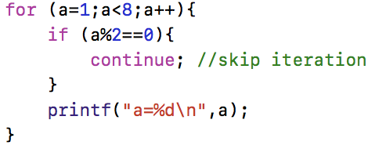
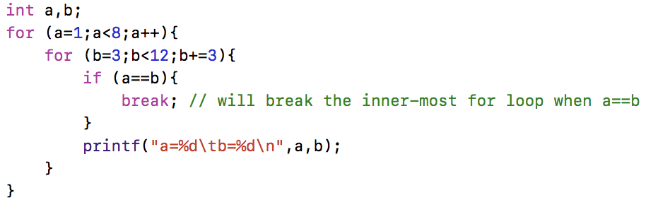
Break and continue
BREAK
Terminate the loop or case
Break will exit only enclosed loop
CONTINUE
Skip the loop iteration

Slide 4
Commands to help check…
Requires header file: ctype.h
Command | Meaning
isalnum(c) | checks if c is alphanumeric (isalpha(c) || isdigit(c))
isalpha(c) | checks if c is alphabetic
isdigit(c) | checks if c is decimal digit
iscntrl(c) | checks if c is a control character
islower(c) | checks if c is lowercase
isupper(c) | checks if c is uppercase
isprint(c) | checks if c is printable (includes space)
isspace(c) | checks if c is white space (space, tab, or new line)
ispunct(c) | checks if c is punctuation
tolower(c) | convert c to lowercase
toupper(c) | convert c to uppercase

Slide 5
Working with external files will be on computer test
C can access external data files – operations are once again low-level (closer to bit-level operations).
Data is stored as binary values on the disk – each operating system stores data differently.
The C compiler adds appropriate calls to access this data.
When a file is accessed:
Code has to search for the file at a location (working directory of compiled code if relatively addressed)
Read file into working memory
Allow interface with c functions
Write file back into storage memory

Slide 6
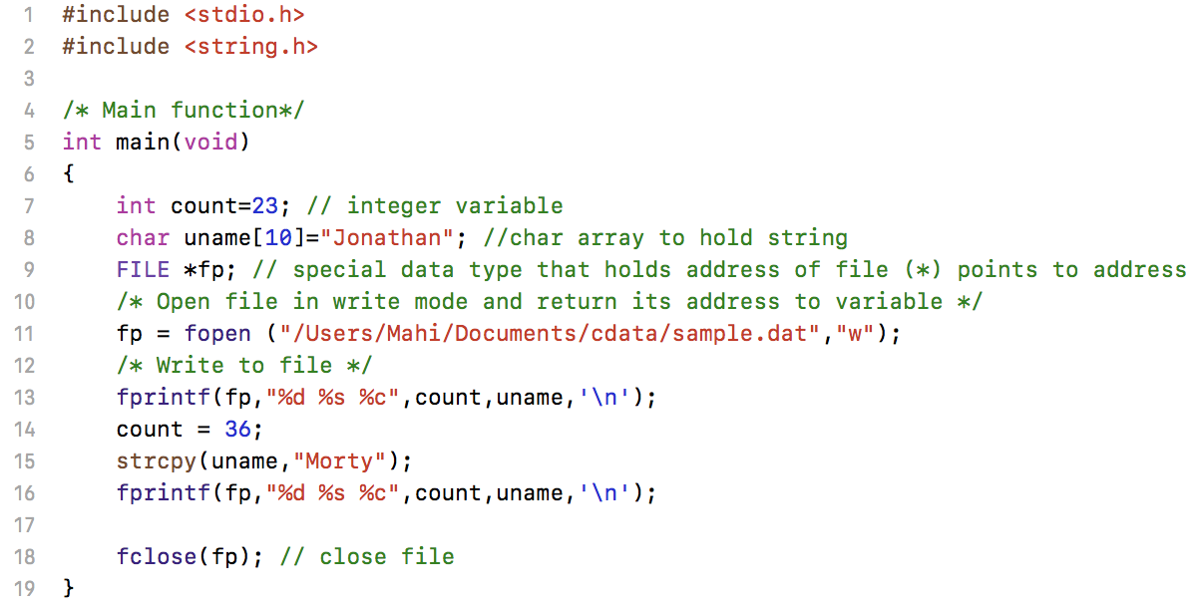
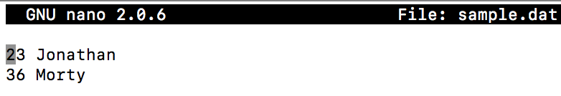
File I/o in C

Slide 7
Opening files
fopen is a pre-defined function (stdio.h) that:
searches file in storage memory
loads file into working (buffer) memory
sets up character pointer to the first character of the buffer
depending on “mode” of file opening, writes the file back to storage
Syntax: fopen(“path/file name”, “[mode]”);
fopen(“data.dat” , “r”);
Mode: written as a string (“ “)
”r”: read mode only. Opens file to read, does not write anything back to storage.
“w”: write mode. Opens file to read, overwrite file (deletes existing data) back to storage.
“a”: append mode. Opens file to read, write new data after current data (append data) in storage.

Slide 8
Reading/writing files
fopen only loads the file into memory
You still need other functions to read from data from file in memory
Use (both included in stdio.h):
fprintf: to write formatted data to file
fscanf: to read formatted data from file
Syntax:
fprintf(filepointer,”format string”,variables);
fprintf(fp,”%d %s”,12,”Max”); //fp is file pointer
fscanf(filepointer,”format string”,address of variables);
fscanf(fp,”%d %s”,&count,&uname); //fp is file pointer

Slide 9
FILE commands
Command | Meaning
FILE | FILE *[filenamevariable]; EXAMPLE: FILE *fdata fdata is a file pointer FILE definition included in <stdio.h> FILE is a type name, like int or char
fopen | fdata = fopen(name, mode); name: a character string containing the name of the file mode: a character string, which indicates how one intends to use the file; allowable modes include read (“r”), write (“w”), and append (“a”)
fclose | fclose(fdata); inverse of fopen breaks the connection between the file pointer (fdata) and the external name that was established with fopen, freeing the file pointer for another file
fscanf | fscanf(fdata, format, arg1, arg2, …); identical to scanf except that the first argument is a file pointer that specifies the file to be read or written
fprintf | fprintf(fdata, format, arg1, arg2, …); identical to printf except that the first argument is a file pointer that specifies the file to be read or written

Slide 10
File Modes
Syntax: variable_file_pointer = fopen (“filepath”,”mode”);
Mode | Description
r | Read mode only. If file exist, it opens file to read. Does not write to storage. If file does not exist, returns NULL.
w | Write mode only. If file exists, it erases current data. Writes new data to storage. If file does not exist, creates a new file.
a | Append mode only. If file exists, it opens file. Writes new data to end of file in storage. If file does not exist, creates a new file.
r+ | Read and write mode. If file exists, it opens file to read. Erases current data and writes new data to storage. If file does not exist, returns NULL.
w+ | Similar to r+ Only difference: If file does not exist, creates a new file.
a+ | Similar to w+ Only difference: read occurs from beginning of file, write occurs at end of current data
rb,rb+,wb, wb+,ab,ab+ | Corresponding modes for binary files

Slide 11

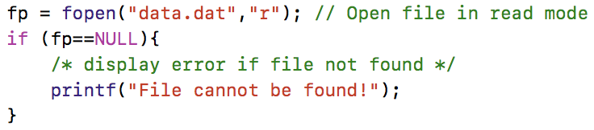
How to check for
End of data bit or “End Of File”:
A state of file that represents its end.
fscanf returns EOF if reached, else returns number of scanned items.
In STDIO, EOF is a defined term. EOF is displayed as -1 when converted to integer.
File does not exist:
fopen returns NULL
In STDIO, NULL is defined as 0.

Slide 12
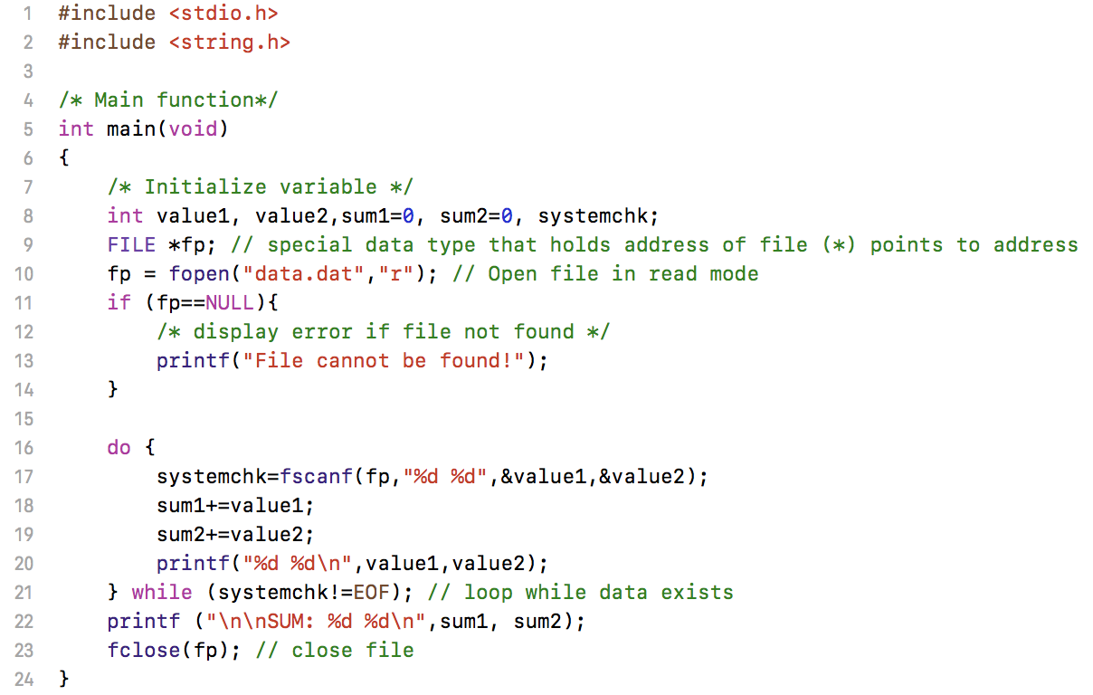
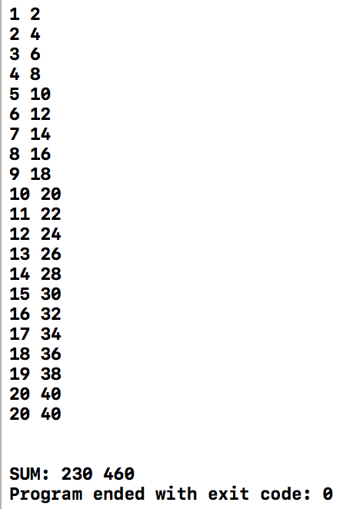
Sample

Slide 13
Where to store file
Absolute address: Anywhere
WIN: fopen (“C:\Users\Jon\CDATA\data.dat”,”r”);
MAC: fopen(“/Users/Jon/data.dat”,”r”);
Relative address: Stored in folder where executable is run from
WIN & MAC: fopen (“data.dat”,”r”);
XCODE: Follow steps on next slides. Files are stored in same folder as selected working directory.
Visual Studio: Files are stored in same folder as c-code written by you.

Slide 14
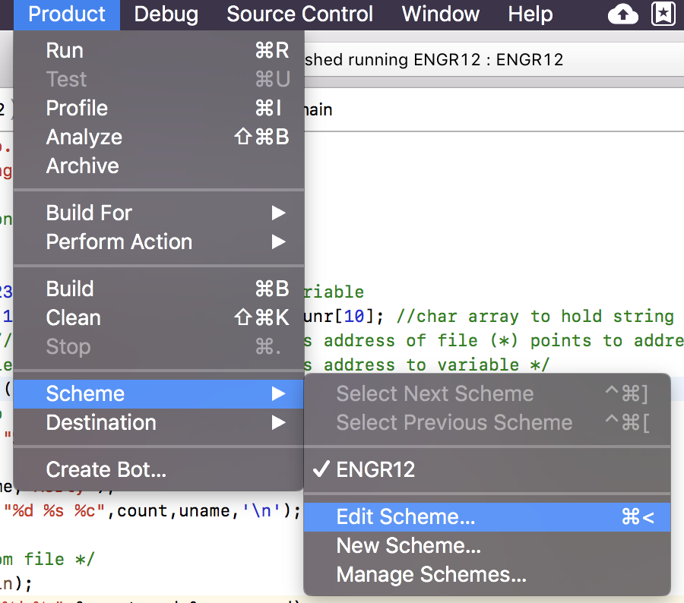
XCODE

Slide 15
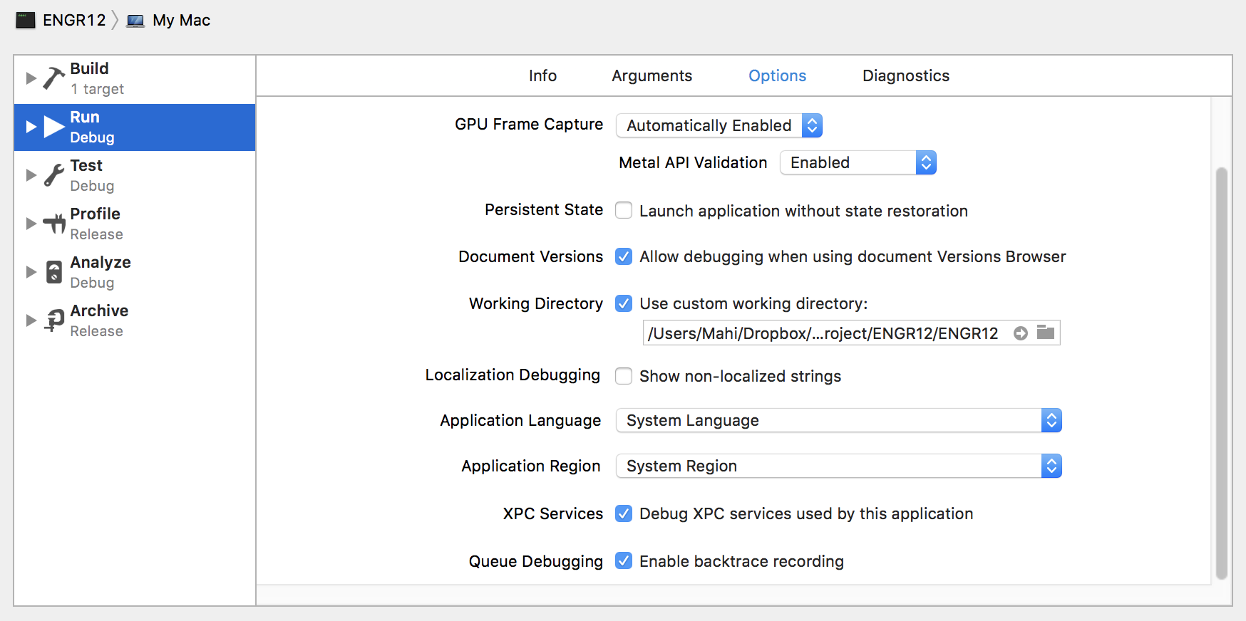
XCODE
Attention:
Set current working directory: retrieve and store files here

Slide 16
Download Handout

